Slide 1
Inधन
Name: Tejas Pant
Roll no: 648
Date: 2019/03/25

Slide 2
Project Introduction & Objective
Inधन is a one stop solution to track your fill-ups, fuel consumption, vehicle costs, average vehicle's mileage, maintenances and keep records to help minimize expenses with maximum possible performance as here in Inधन, efficiency matters.

Slide 3
Literature Review
https://www.fleetco.space/
Fleetco is foreign web-based vehicle fleet maintenance management system designed for trucking companies.

Slide 4
Requirements Elicited
Functional Requirement:
Authentication(Login, Logout)
Input data from User
Efficiency/Maintenance/Tax Payment Report Generation
Non-Functional Requirement:
Secured maintenance of data
User friendly UI
Up-to-date knowledge of vehicle related expenses

Slide 5
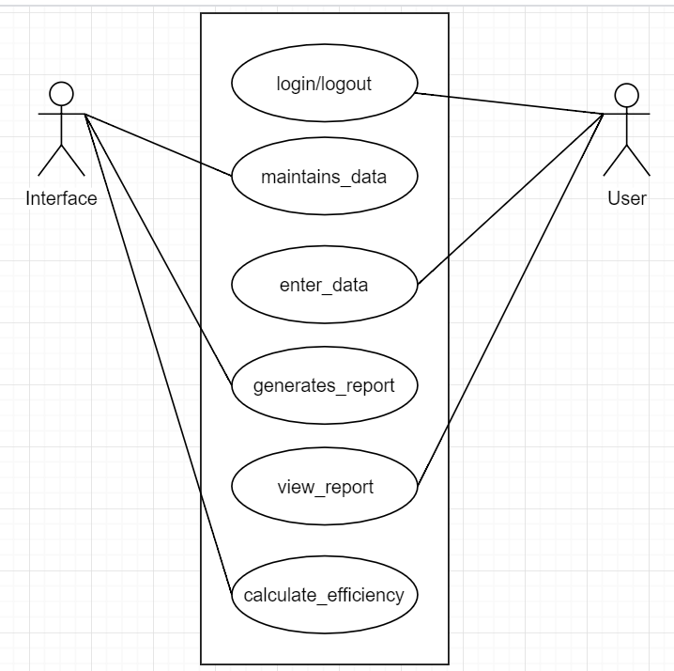
UML Diagram- Use Case Diagram

Slide 6
Thank You!

